Slide 1
The Peaks at Chapin
Resource Housing Group, Inc.
Chase Northcutt

Slide 2
Resource Housing Group- General Partner and Developer
Owner/developer of affordable housing for approximately 20 years
Primarily in Georgia but properties throughout the southeast
Two properties in South Carolina developed
Pelham Village- 60 units in Greenville
Carolina Oaks- 48 units in Myrtle Beach

Slide 3
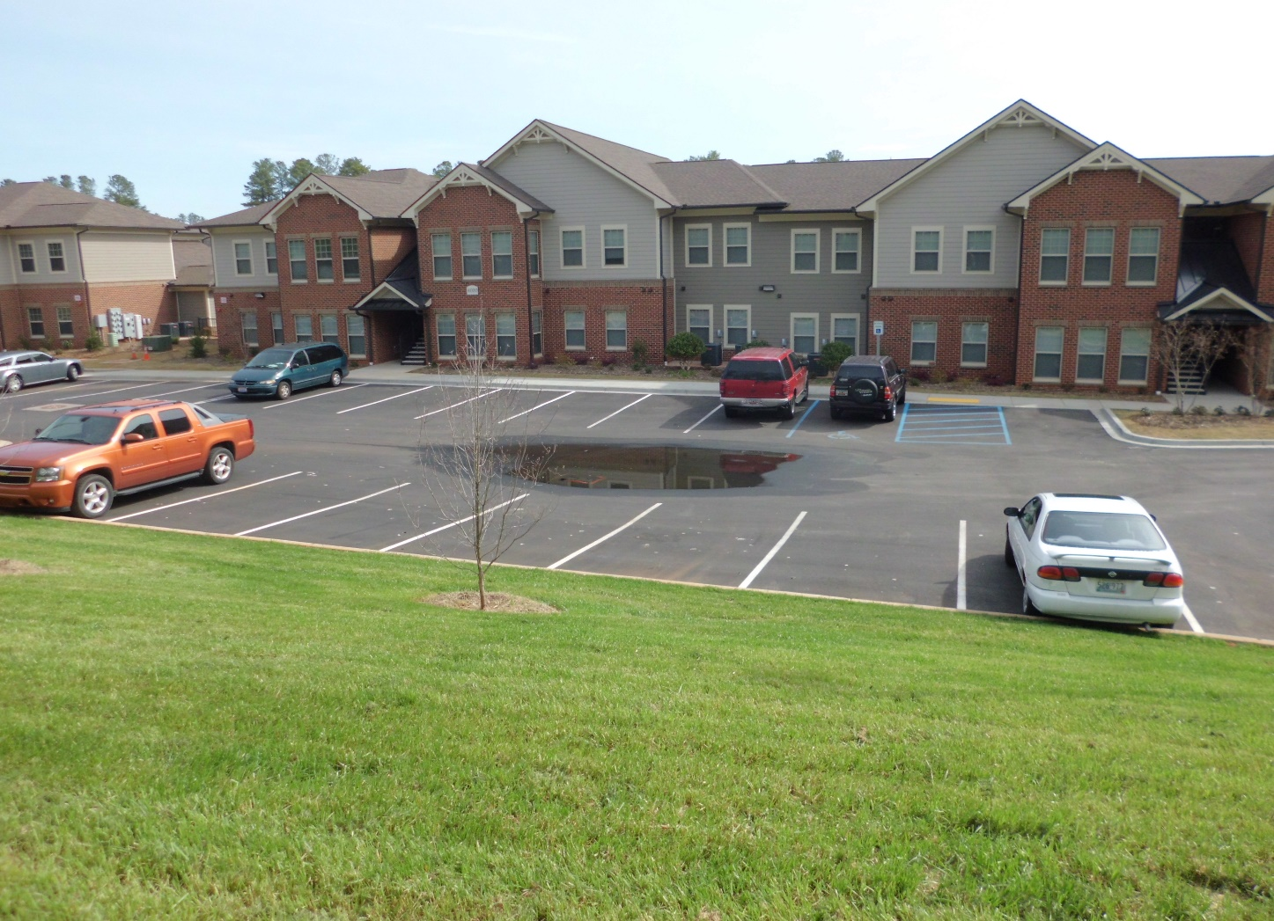
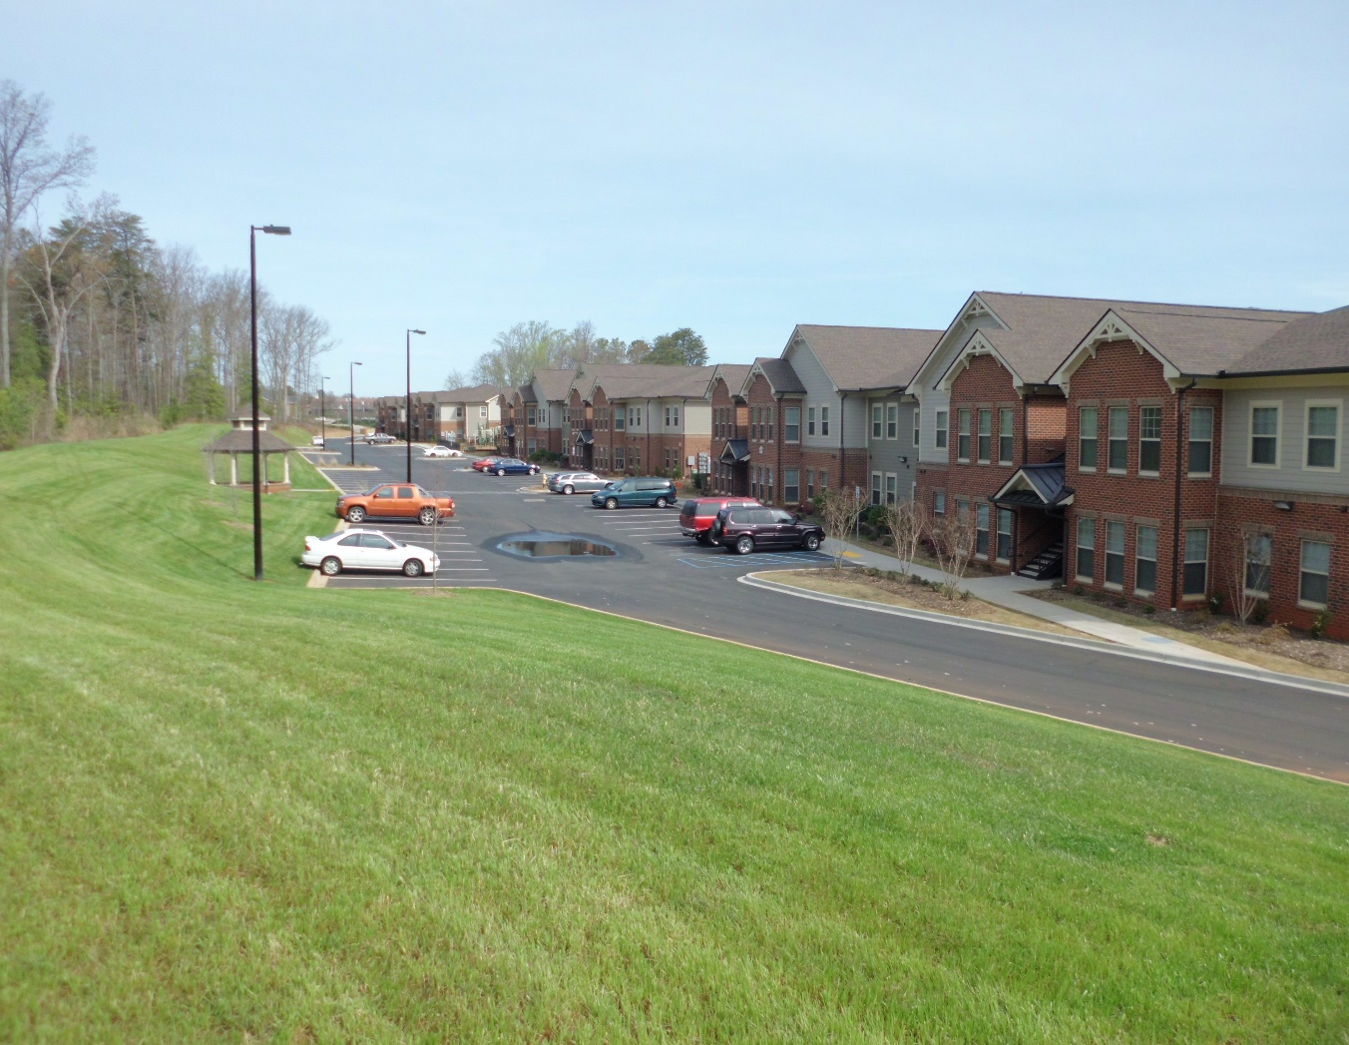
Pelham Village- Greenville, SC

Slide 4


Pelham Village-

Slide 5
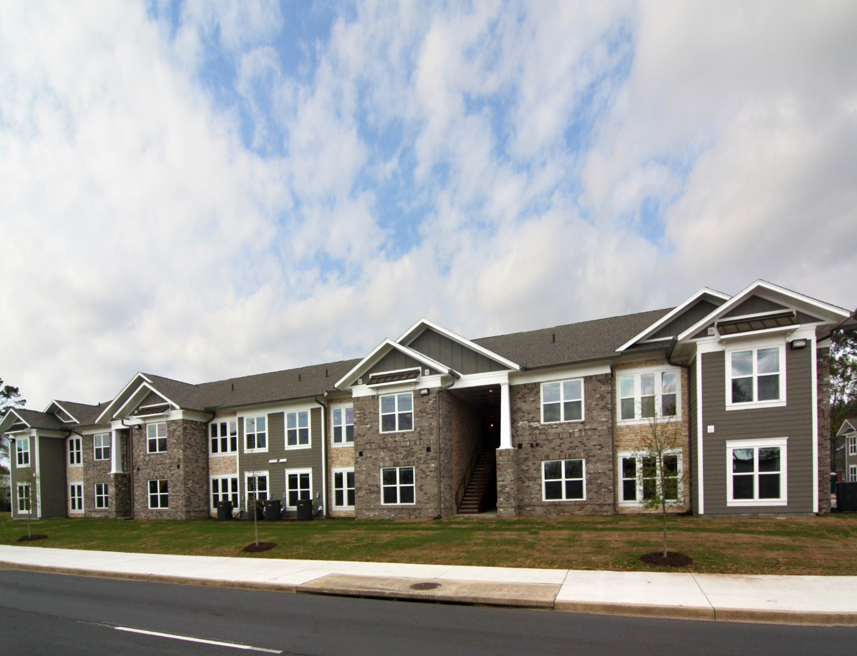
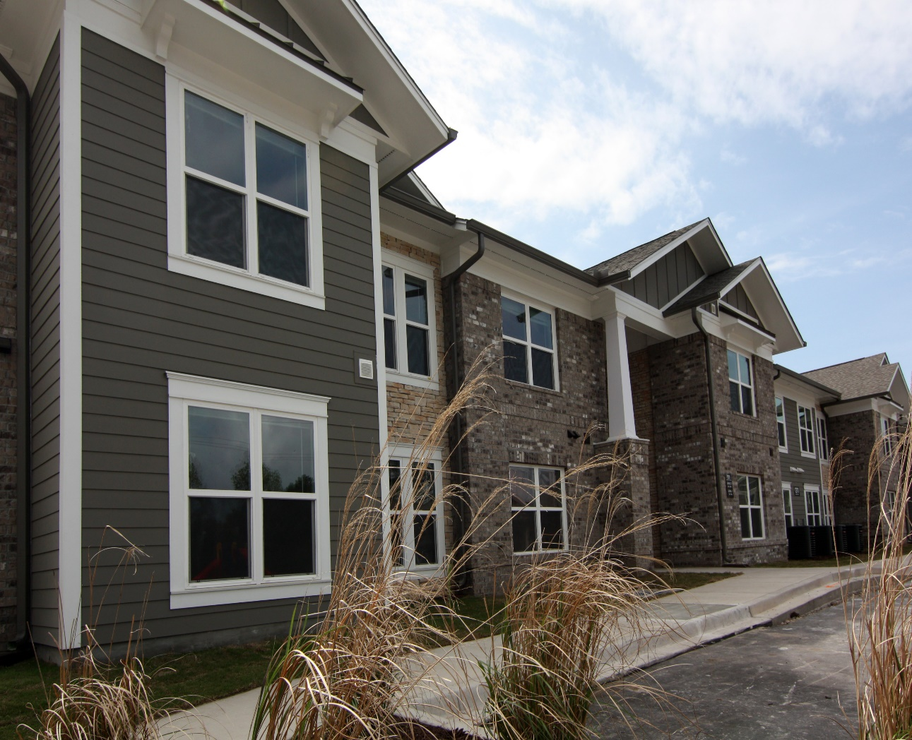
Carolina Oaks- Myrtle Beach, SC

Slide 6
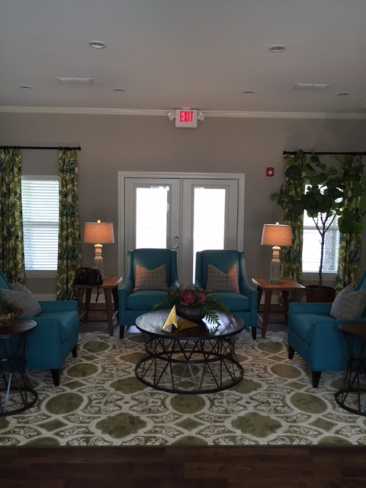
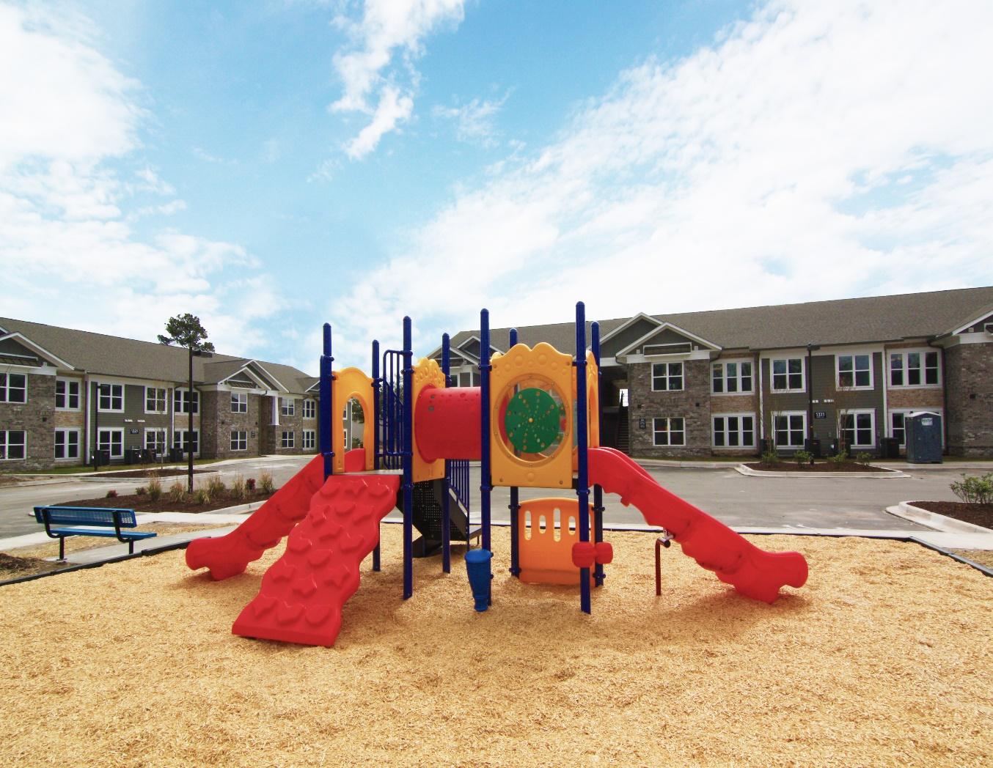
Carolina Oaks- Myrtle Beach, SC

Slide 7
Proposed Project Team Members
Architect- Studio 8 Design
Contractor- Prestwick Construction
Management Company- Gateway Management Company
Engineering firm- Site Design
Niemann Consulting Group

Slide 8
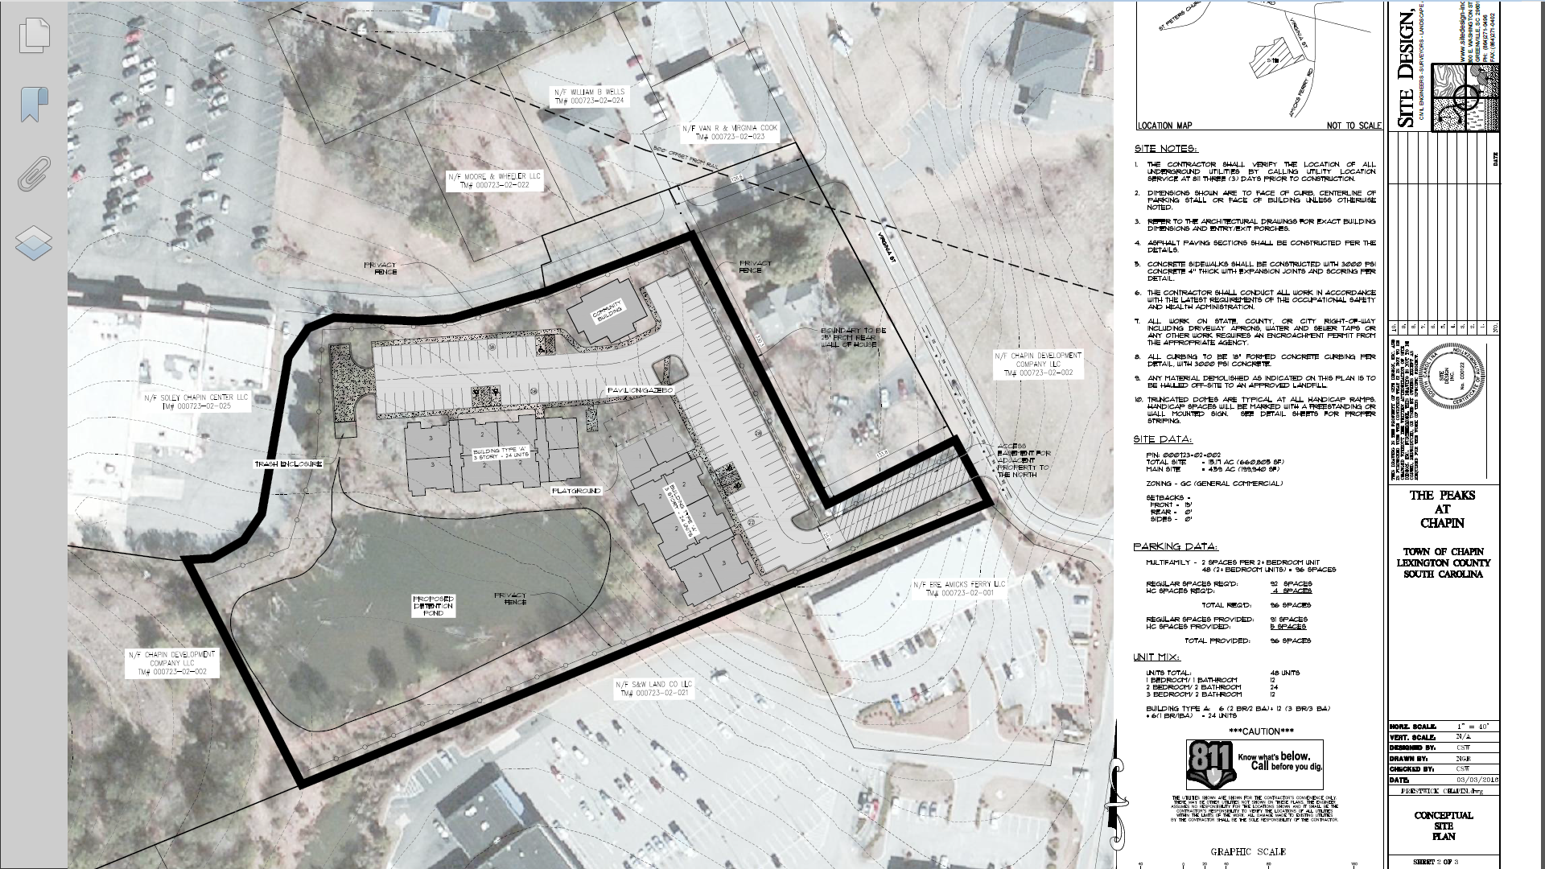

Slide 9
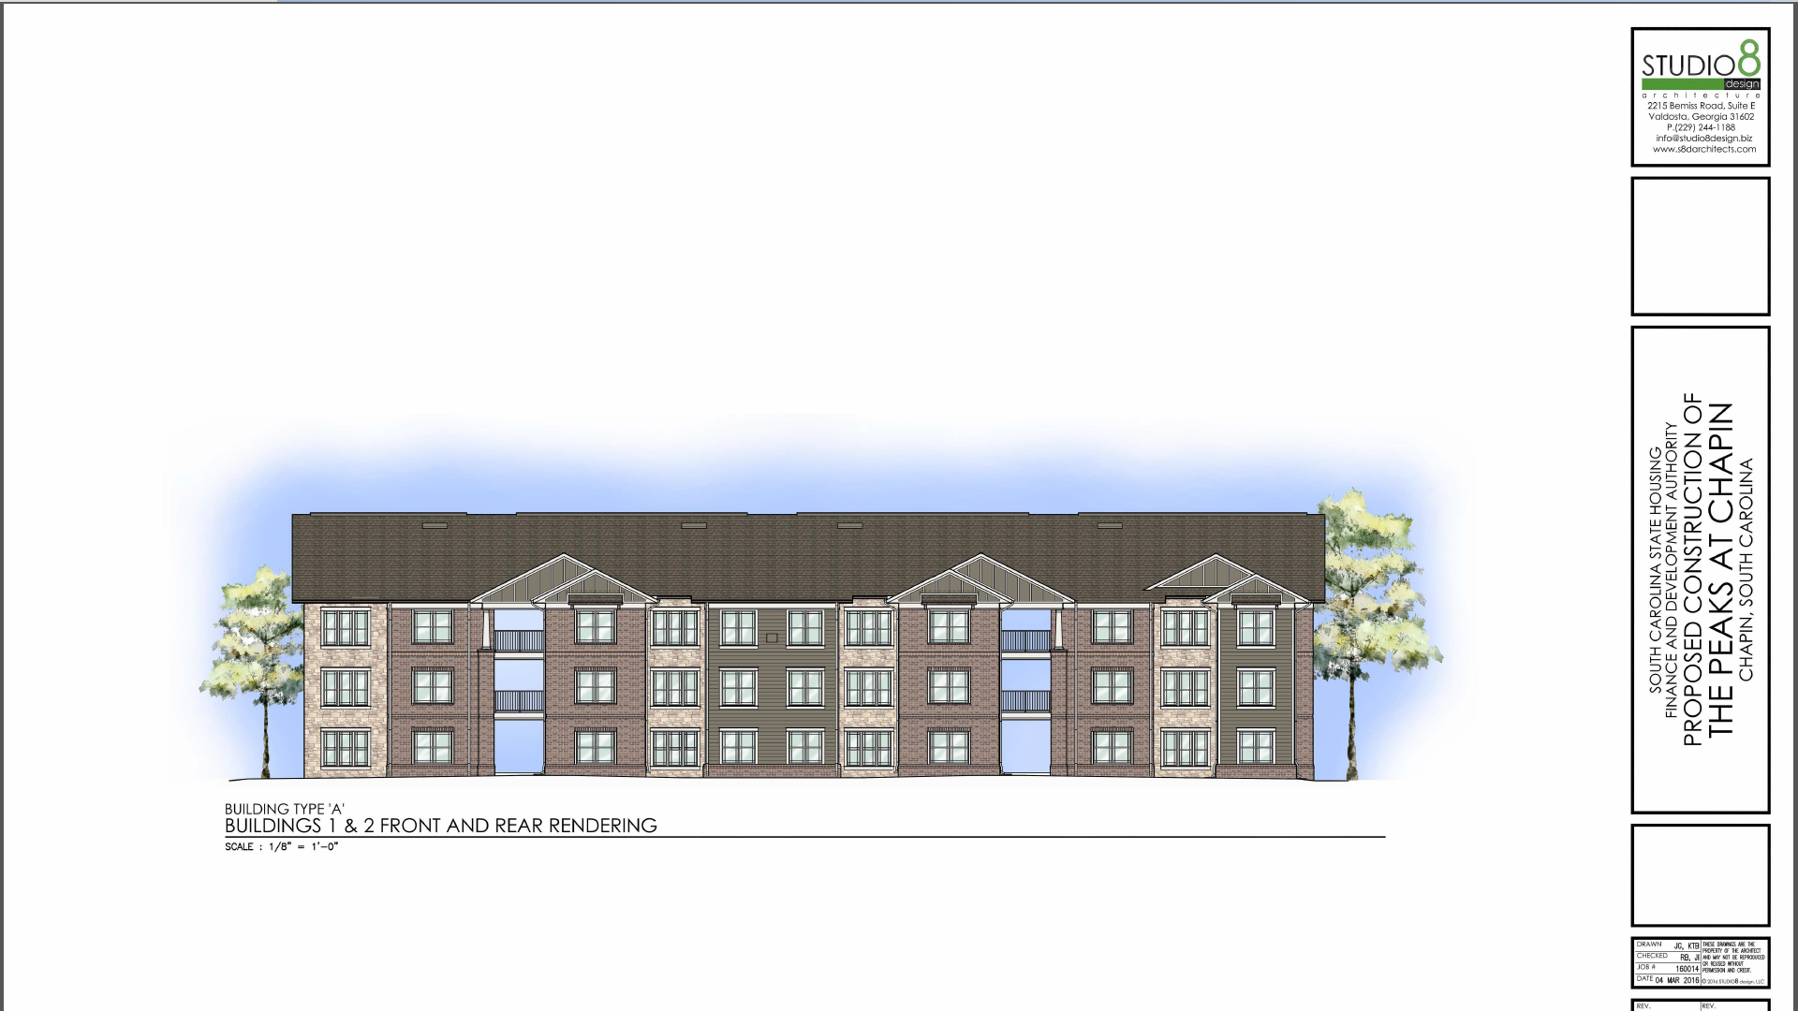
Elevation

Slide 10
Project Description
Approximately $7.5 million development project
48 units
2 Buildings and 1 Clubhouse
1 BR units- 12 ( approximately 753 sq ft)
2 BR units- 24 ( approximately 965 sq ft)
3 Br units- 12 ( approximately 1125 sq ft)
12 units rented to tenants making 50% of Area Median Income
36 units rented to tenants making 60% of Area Median Income

Slide 11
Project Description
Rents calculated using National Income Limits provided for Lexington County
Rental Rates
1BR- $440 and $500
2BR- $515 and $600
3BR- $550 and $700

Slide 12
Tax credit program
Submit an application to the state housing agency and compete against projects throughout the state
Application with the highest scores are awarded tax credits
In return for the tax credits the owner/developer agrees to keep the property affordable and in compliance with the commitments made in the application for a period of 15 years
Tax credits are then sold to large institutions and the equity is used to fund the project
Conventional debt is used to finance the remainder of the project

Slide 13
Tax credit program
15 year ownership and guarantees from the developer/owner
Syndicators/ Lenders monitor their investment
Properties are monitored by the state housing agency
Monitoring of the physical plant
Monitoring of the tenant files
Mandatory Design criteria usually more strict than local community design requirements

Slide 14
Tenant Selection Criteria
Criminal background checks
Credit checks
Income qualifications- both maximum and minimum
Job verification
Tenants only approved after corporate review of file
2 people per bedroom limit
Quarterly inspection of units
Not a SECTION 8 Property

Slide 15
Closing
Property is zoned correctly
Comprehensive plan updated in 2011 concluded the town lacks a diversity of housing
Working class people

